Slide 1

Targeting Drowsy Driving for Safer Drivers, Safer Roads:
Technology to Culture and Back Again
Clare Anderson, PhD.
Professor of Sleep and Circadian Science
Centre for Human Brain Health, School of Psychological Sciences
University of Birmingham
Adjunct Professor (Research)
Monash University Accident Research Centre (MUARC)

Slide 2
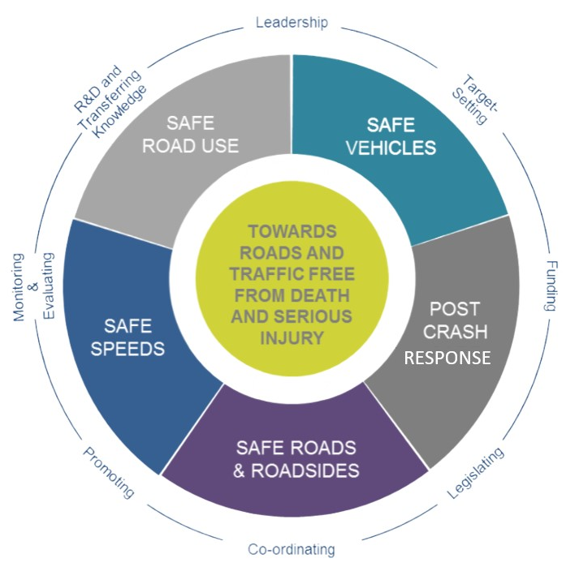



Road Safety as a Safe System
Drivers
Shared Responsibility
Principle to Practice?
Organisations
Source: https://www.pacts.org.uk/safe-system/

Slide 3


Targeting Drowsy Driving
Overview
DROWSY DRIVING
  Causes and Consequences of Drowsy Driving
  Countermeasures to Drowsy Driving
ROAD SAFETY AS A SHARED RESPONSIBILITY
  Key Driver Factors
  Key Organisational Factors
SUMMARY
Principle to Practice
Fatigue Risk Management Solutions
PresentionGO.com

Slide 4

Drowsy Driving
Causes
Consequences
Countermeasures
Targeting drowsiness for safer drivers, safer roads

Slide 5

What causes drowsiness & fatigue?
DROWSINESS
1.
2.
3.
4.
5.
FATIGUE
Total sleep loss
Sleep debt
Time on Task
Cognitive Load
Stress
Physical Exertion
Medical Conditions
Time of day
Sleep inertia
Sleep disorders

Slide 6
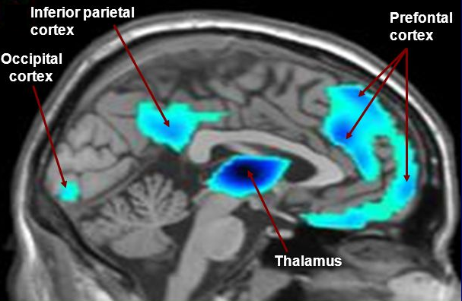




Sleep Deprivation: Consequences
The sleep deprived brain
Alertness & Attention
Cognitive Function
Emotional Regulation
Likelihood Falling Asleep
Reduced Concentration
Delayed Response Time
Lapses in Attention
Distractibility
Task switching
Logical Reasoning
Memory Problems
Poor Decision Making
Impulsivity and Lack of Inhibitory control
Poor Communication
Flexible thinking or goal directed behaviours
Frustration
Irritability
Emotionally Reactivity
Poor Social Interactions

Slide 7

Drowsy Driving:
How it unfolds
Sleep Deprivation: Consequences
Speed inconsistent
Poor concentration
Boredom
Stiffness, aches, cramps
Feeling restless
A Driving Perspective
Blinking more than normal
Daydream, distraction
Sore, tired eyes
Resting eyes at a stop light
Feeling drowsy or tired
Making errors
Difficulty keeping control
Falling asleep (microsleep)
Mood changes

Slide 8
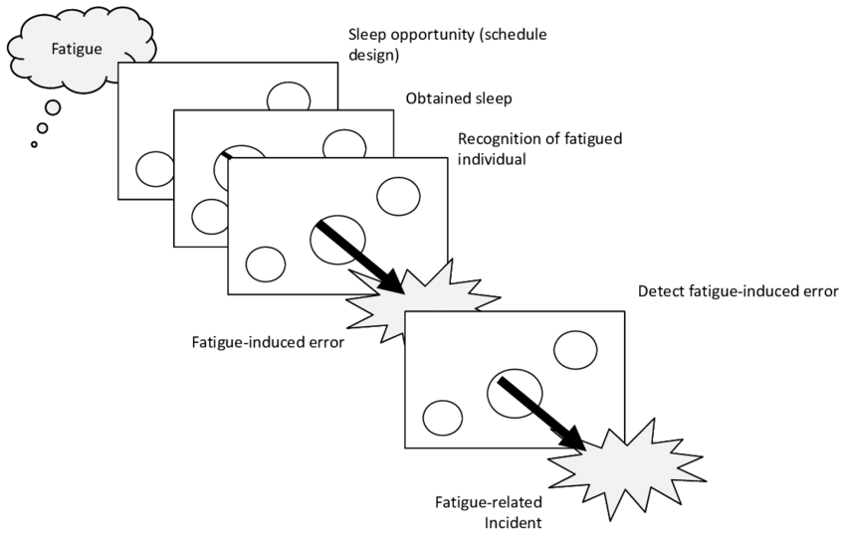
Countermeasures for Drowsy Driving
Hours of work and rest
Education and awareness
Technological solutions
Biomathematical modelling
Predictive technology
Monitoring technology
Incidence Reporting
Countermeasures
Light
Caffeine
Napping
Task load/duration
Jackson, P.G. (2015) Managing Fatigue using a Fatigue Risk Management Plan.

Slide 9
Road Safety:
A Shared Responsibility
Driver and Organisational Factors Involved in Promoting Alertness, Health and Safety.

Slide 10

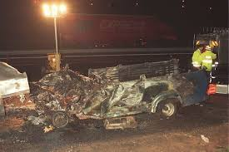
Driver Factors
Sleep guidelines?
1.
Historically, researchers used 5 hours of sleep as 2.9 increase odds in risk of crash where car occupant was injured (Connor et al., 2002)
Prioritise sleep to promote fitness to drive?
Across 6845 drivers involved in a RTC, risk of culpability increased as a function of sleep loss. Relative to those sleeping 7 – 9hours…
Drivers who had 5 hours prior sleep were 2.9 times more likely to be culpable
Drivers who had <4 hours prior sleep were 15.1 times more likely to be culpable (Tefft et al., 2018)

Slide 11
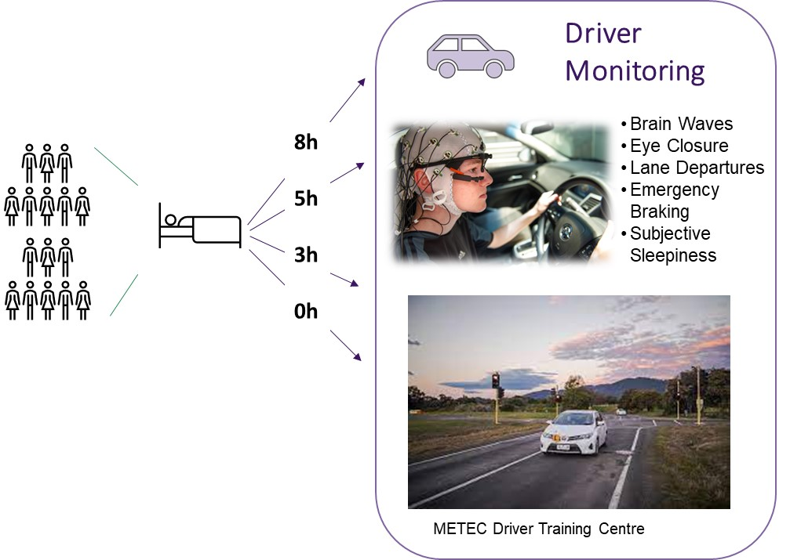
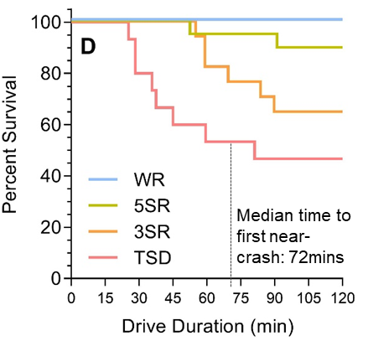
Driver Factors
Sleep guidelines?
1.
Historically, researchers used 5 hours of sleep as 2.9 increase odds in risk of crash where car occupant was injured (Connor et al., 2002)
Prioritise sleep to promote fitness to drive?
Across 6845 drivers involved in a RTC, risk of culpability increased as a function of sleep loss. Relative to those sleeping 7 – 9hours…
<5h sleep = more than 4x crash risk
Manousakis & Anderson (2024). Unpublished

Slide 12
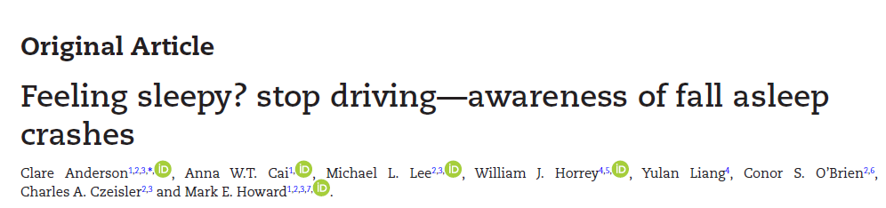
Driver Factors
1.
Prioritise sleep to ensure fitness to drive – ideally at least 6 hours prior to driving
2.
Stop, take a break
Anderson et al. (2023). Sleep, 8, zsad136

Slide 13

Driver Factors
Organisation Factor
1.
2.
Prioritise sleep to ensure fitness to drive – ideally at least 6 hours prior to driving
Stop, take a break – every 2 hours OR when feeling any sign of sleepiness
3.
Report sleepiness, adverse events, sleep problems, other sleep factors

Slide 14
Organisational Factors
1.
In-Vehicle Technology

Slide 15

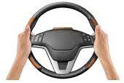


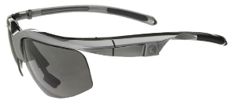
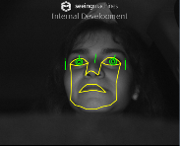
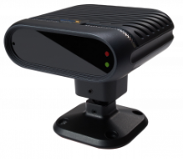
Organisational Factors
1.
In-Vehicle Technology
Active safety systems are an important part of safe systems approach
Seeing Machines TM
AmTech PST©
PVT Workfit ©
Optalert®
SmartCapTM
Geobox©
Cardiowheel©

Slide 16
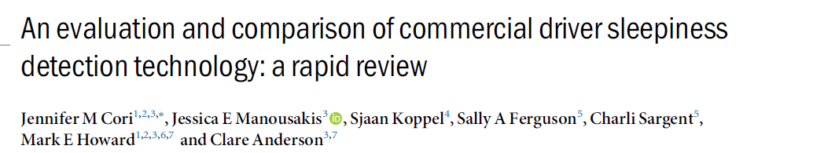


Organisational Factors
1.
In-Vehicle Technology
Active safety systems are an important part of safe systems approach
  Key findings
1. Carefully evaluate technology (validation)
  Ocular-based systems are highly effective for detecting drowsiness (e.g. Anderson et al. 2013, 2018. Cori et al., 2020)
  Prediction technologies have good utility (e.g., Maccora et al. 2018)
2. Accepted by workers/drivers
Continuous Monitoring
  Continuous monitoring technology can be effective. (e.g., Cai et al Sci Rep. 2020)
  Beyond validity, effective implementation and utility of the data is critical
Prediction Technologies
3. Effective utilisation of data
Scheduling Technologies
Native Systems

Slide 17




Organisational Factors
1.
2.
In-Vehicle Technology
Education
Empowerment
E
4 ‘s
Implementation
Effective implementation of technology (or FRMS)
Evaluation
Engagement

Slide 18
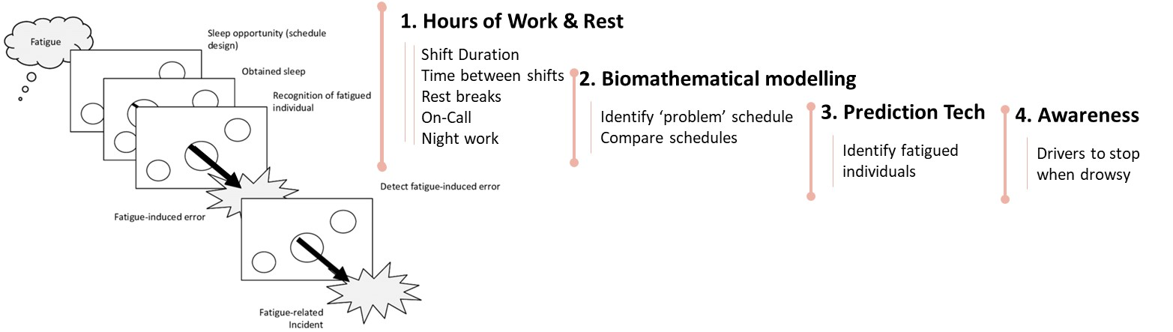
Organisational Factors
1.
2.
3.
In-Vehicle Technology
Implementation
Culture

Slide 19
Organisational Factors
1.
2.
3.
In-Vehicle Technology
Implementation
Detect/ Report
How do we minimise this?
Culture
Solution
Jackson, P.G. (2015) Managing Fatigue using a Fatigue Risk Management Plan.

Slide 20




Organisational Factors
Driver Factors
1.
2.
3.
Just Culture for fatigue
In-Vehicle Technology
Leadership
▪ Visible and accessible ▪ Approachable. ▪ Clear expectations around competencies. ▪ Role model.
Implementation
Education
▪ Create confidence and shared beliefs. ▪ Promote understanding fatigue. ▪ Company systems & technology.
Open Comms
▪ Free from judgement. ▪ Joint decision making. ▪ Team solutions to adverse events.
Culture
Accountibility
▪ Clear expectation setting to promote shared and balanced accountability.
Adapted from Murray et al. (2023). Requirements for implementing a ‘just culture’ within healthcare organisations: an integrative review. BMJ Open Quality. 12:e002237

Slide 21
Summary Remarks
Drowsiness (and fatigue) are caused by an inter-play of multiple factors
Fatigue risk management therefore requires a multifaceted approached
Road safety is a shared responsibility
Drivers should ensure that they are fit to drive, stop as and when required, and report drowsiness events or concerns
Organisations should utilise systems and technology where possible, ensure it is implemented effectively, and within a just culture.
Any questions?

Slide 22



Targeting Drowsy Driving for Safer Drivers, Safer Roads:
Technology to Culture and Back Again
Clare Anderson, PhD.
Professor of Sleep and Circadian Science
Centre for Human Brain Health, School of Psychological Sciences
University of Birmingham
c.anderson.4@bham.ac.uk
@sleepyclare
https://www.birmingham.ac.uk/staff/profiles/psychology/anderson-clare

